Slide 1



www.groundgurus.com

Slide 2


Slide 3


Slide 4
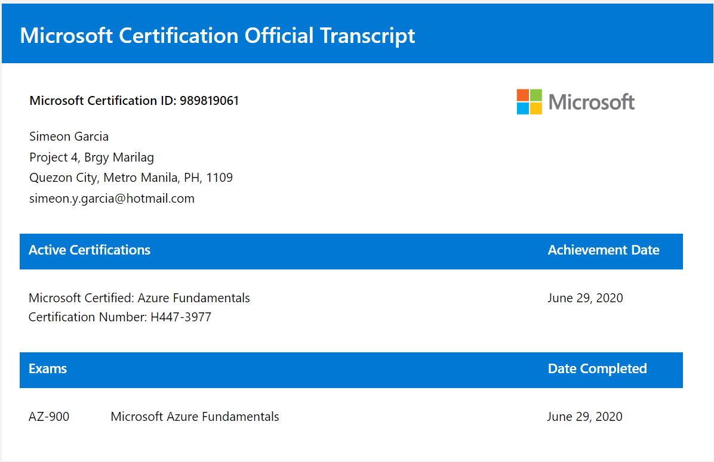

Slide 5
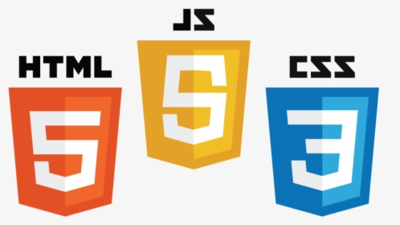

Slide 6

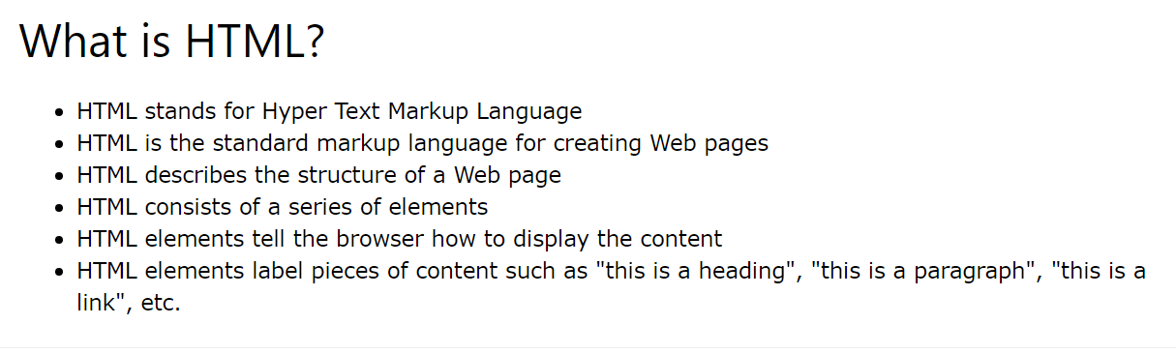

Slide 7
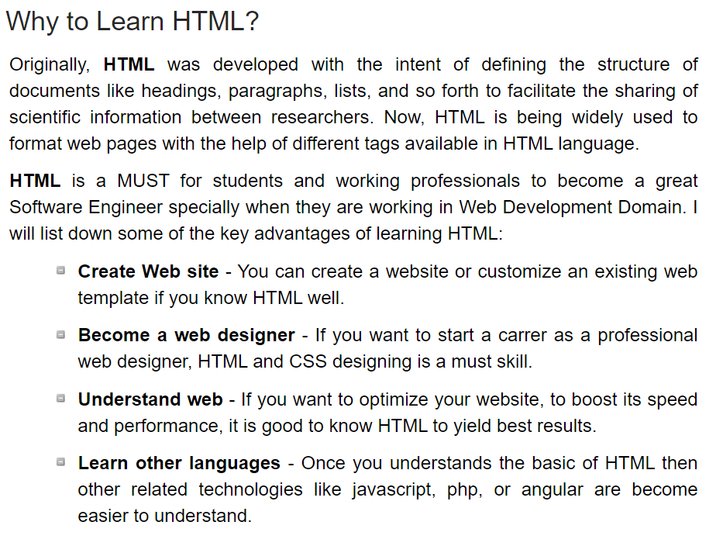

Slide 8
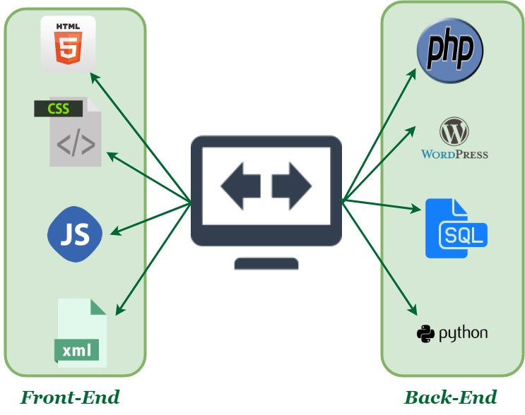
WEB APPLICATION DIAGRAM

Slide 9
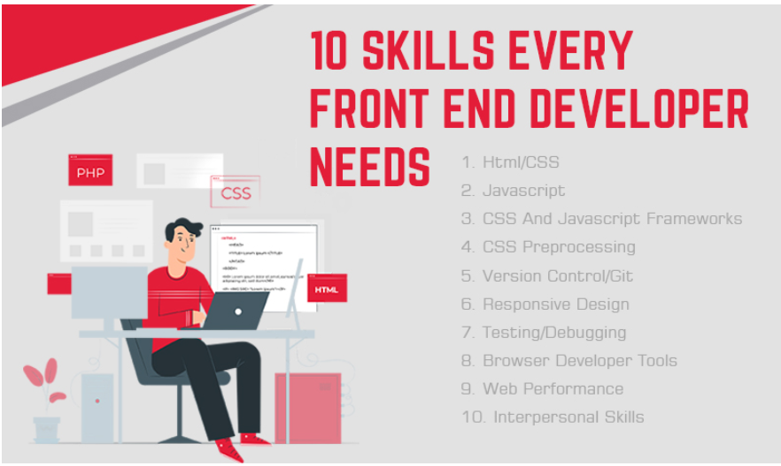
WEB APPLICATION DIAGRAM

Slide 10
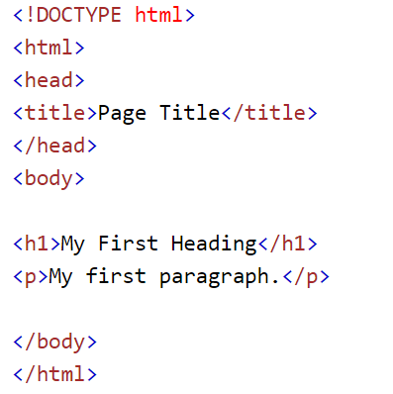
Html Basic Structure

Slide 11
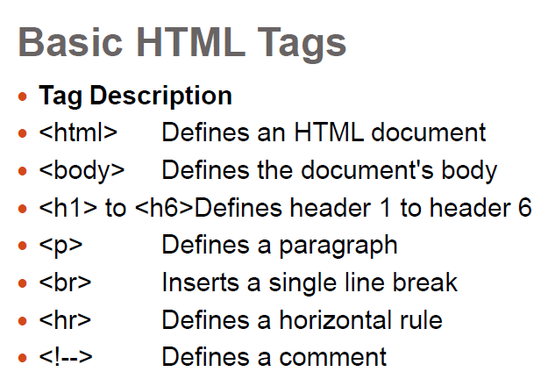

Slide 12
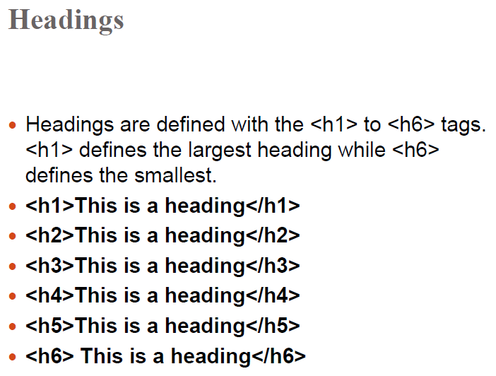

Slide 13
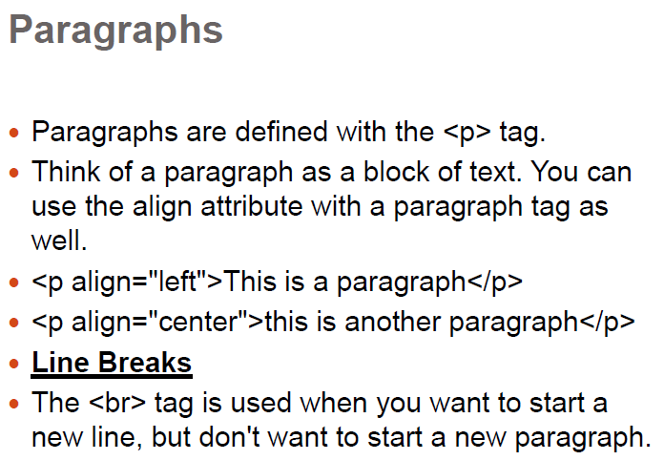
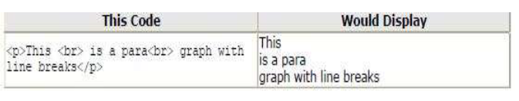

Slide 14
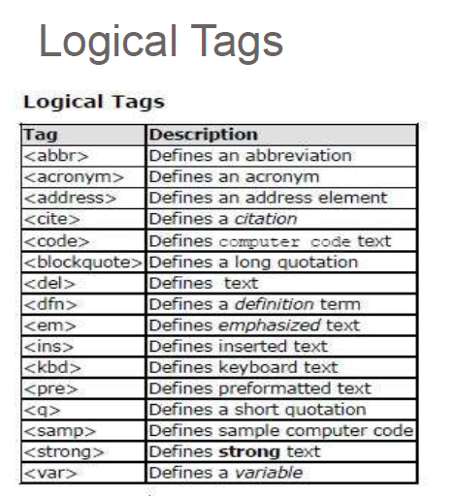
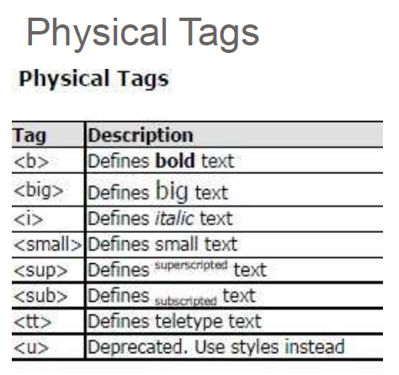

Slide 15
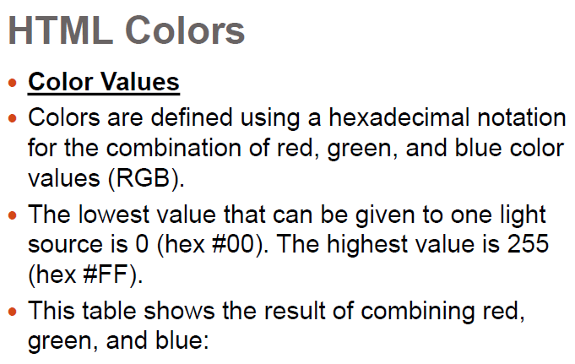

Slide 16
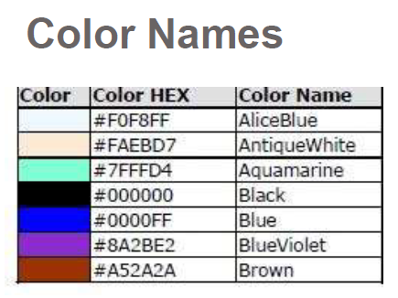
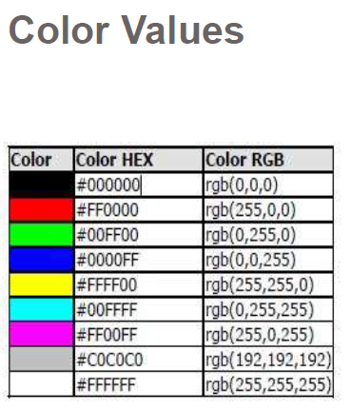
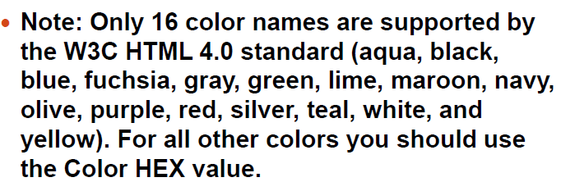

Slide 17
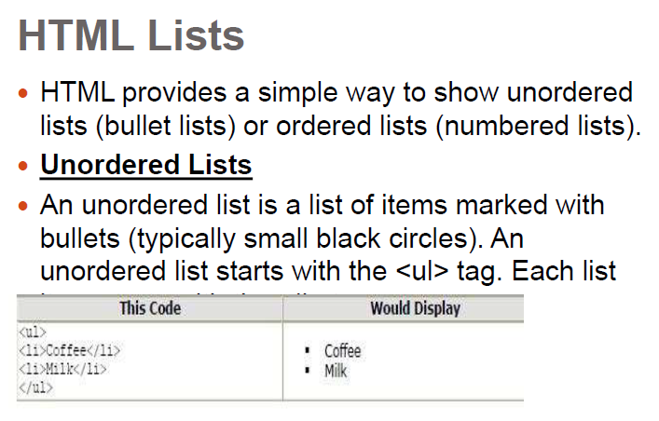

Slide 18
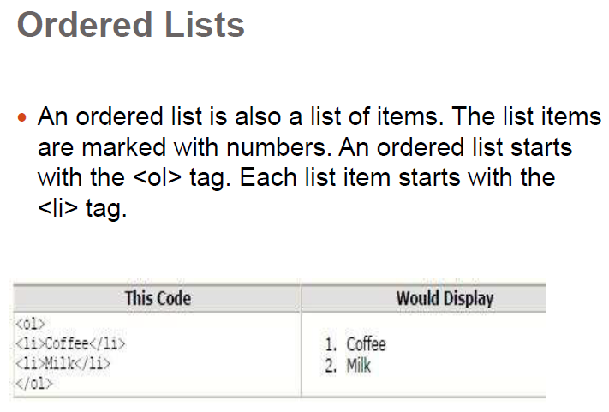

Slide 19
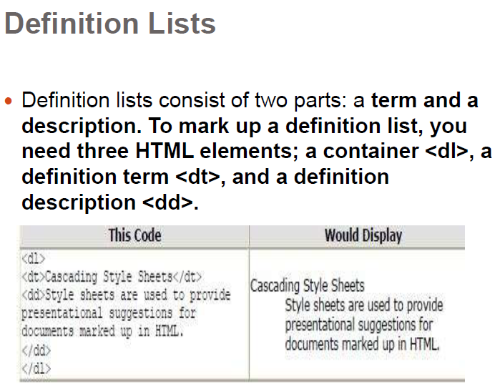

Slide 20
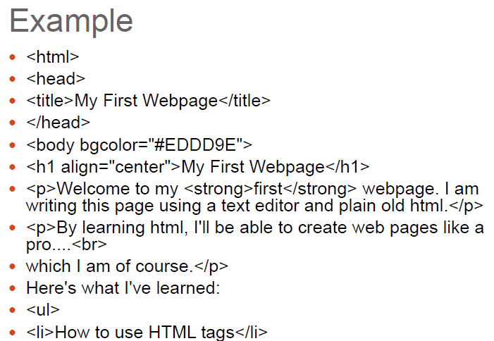
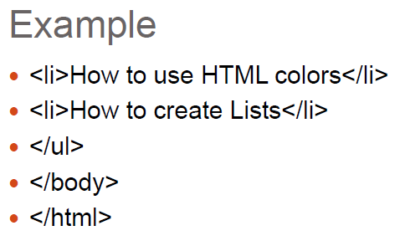

Slide 21
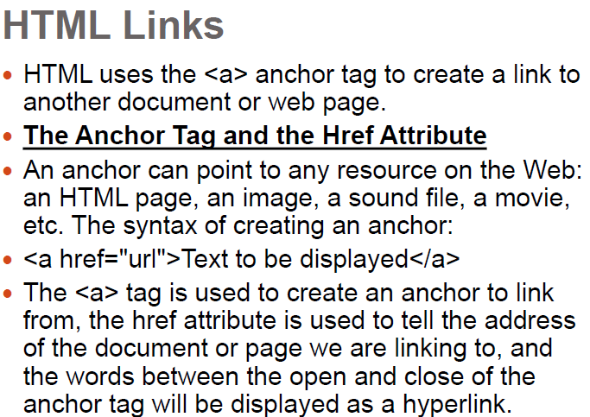

Slide 22
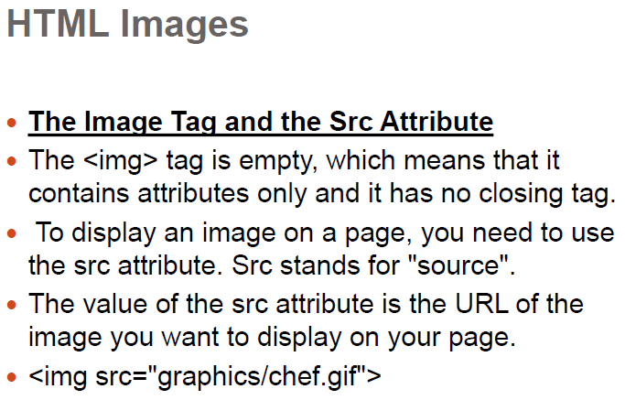

Slide 23
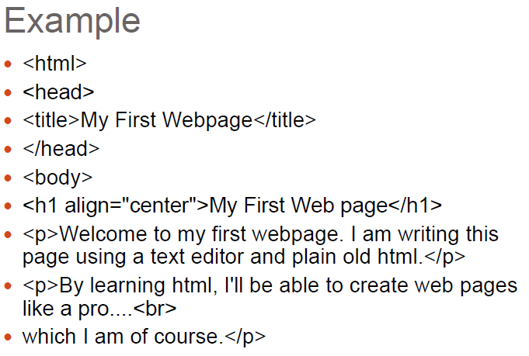

Slide 24
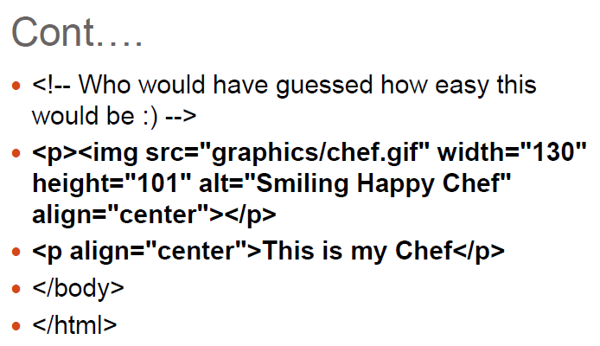

Slide 25
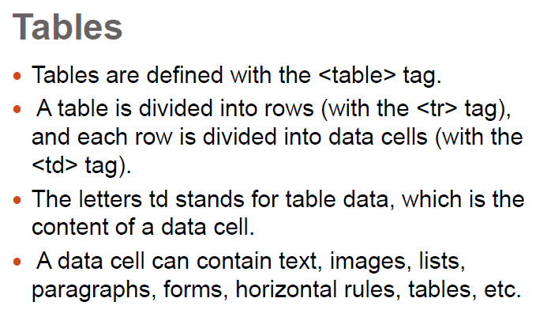

Slide 26
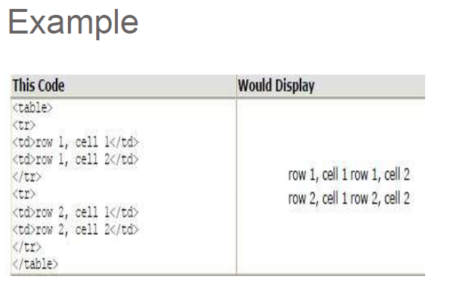

Slide 27
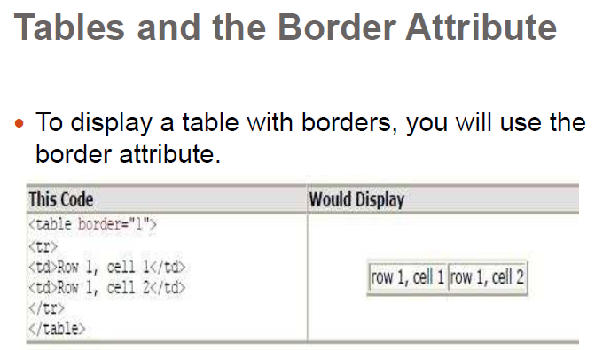

Slide 28
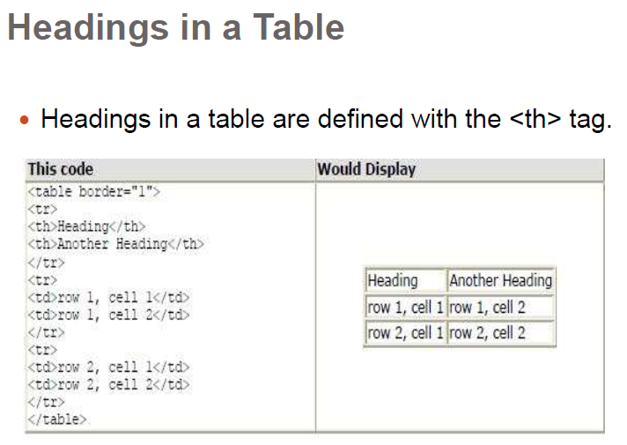

Slide 29
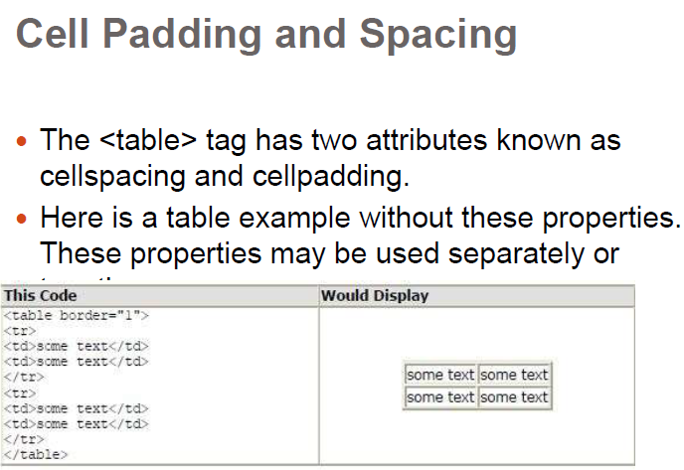

Slide 30
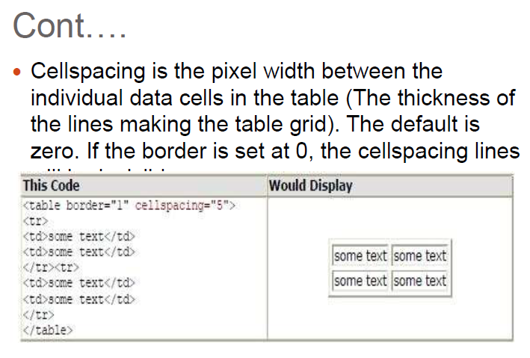

Slide 31
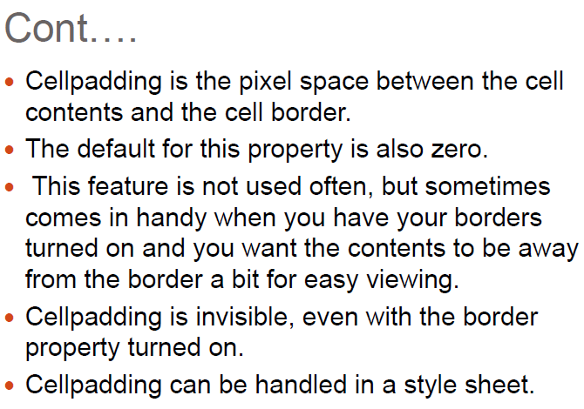

Slide 32
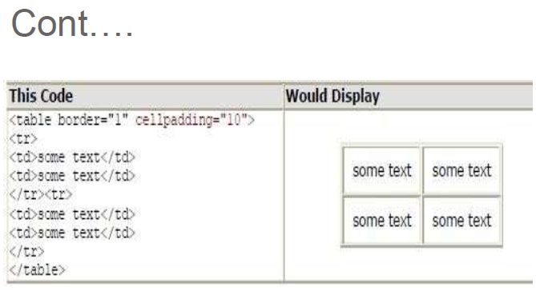

Slide 33
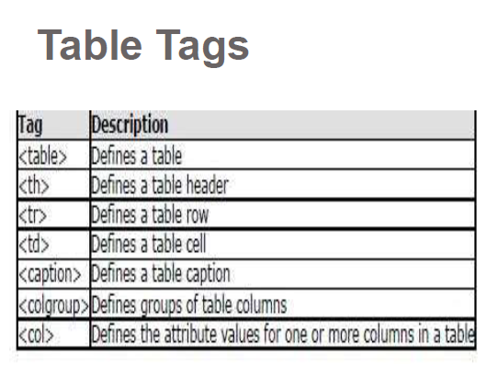

Slide 34
CSS 101
“Give life to your work”

Slide 35
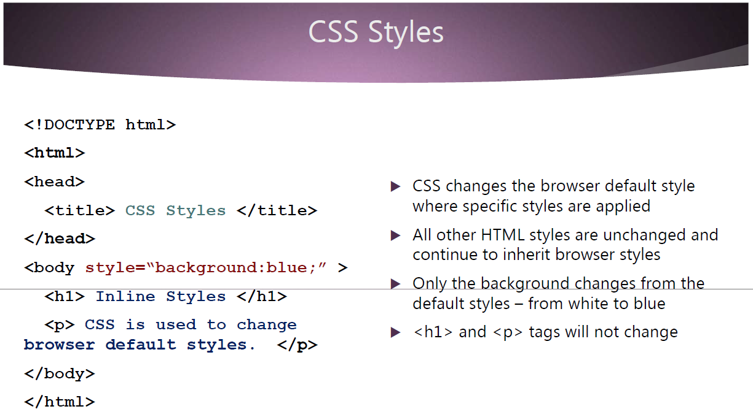

Slide 36
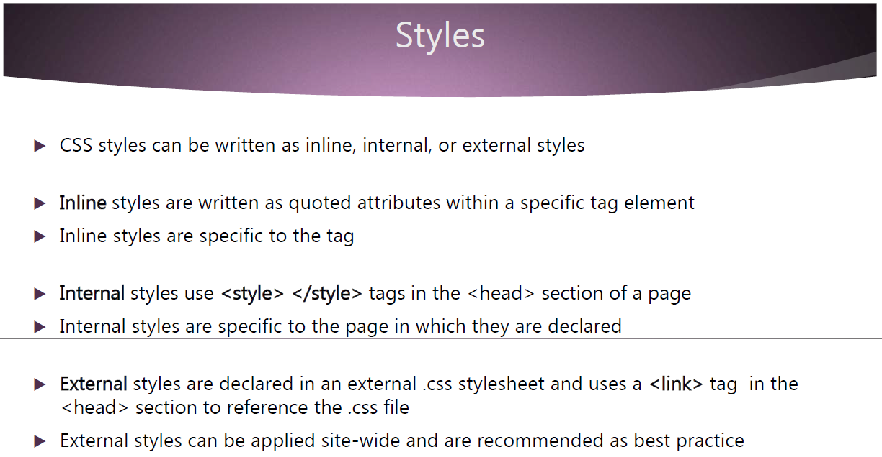

Slide 37
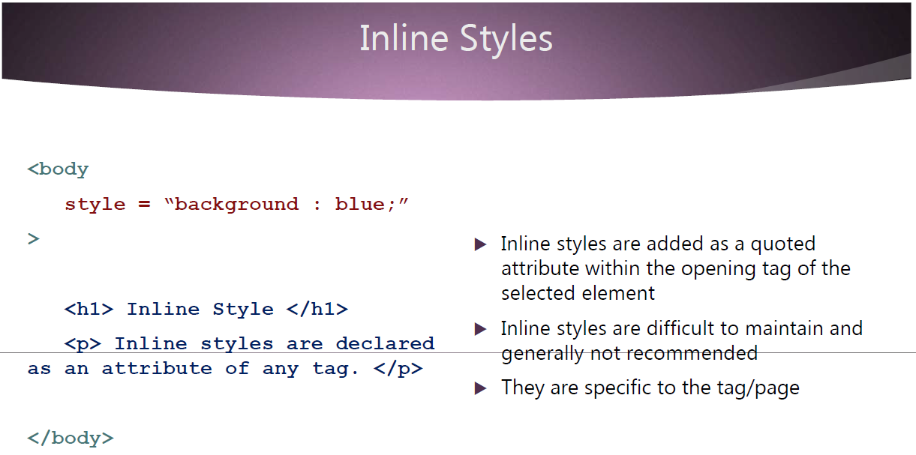

Slide 38
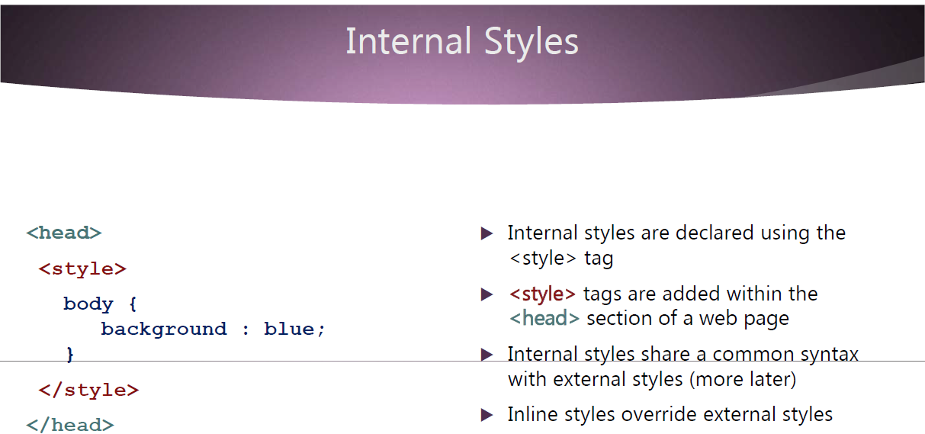

Slide 39
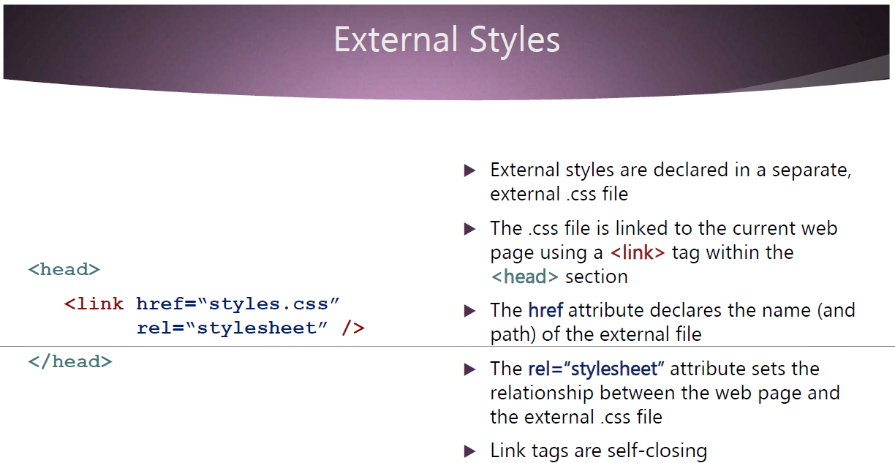

Slide 40
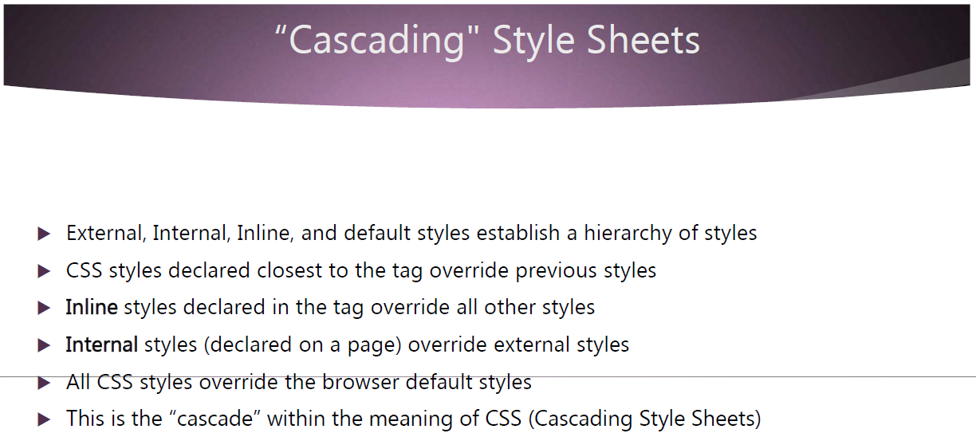

Slide 41
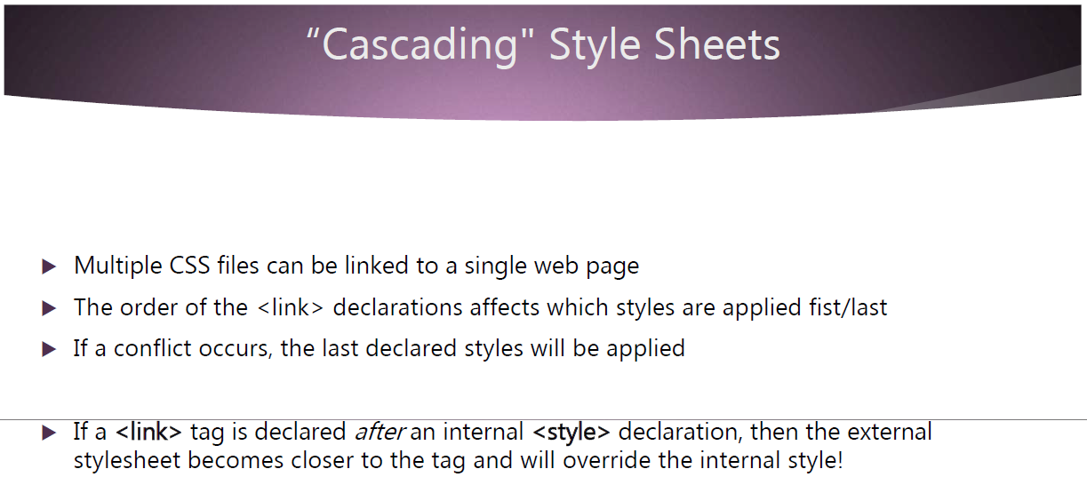

Slide 42
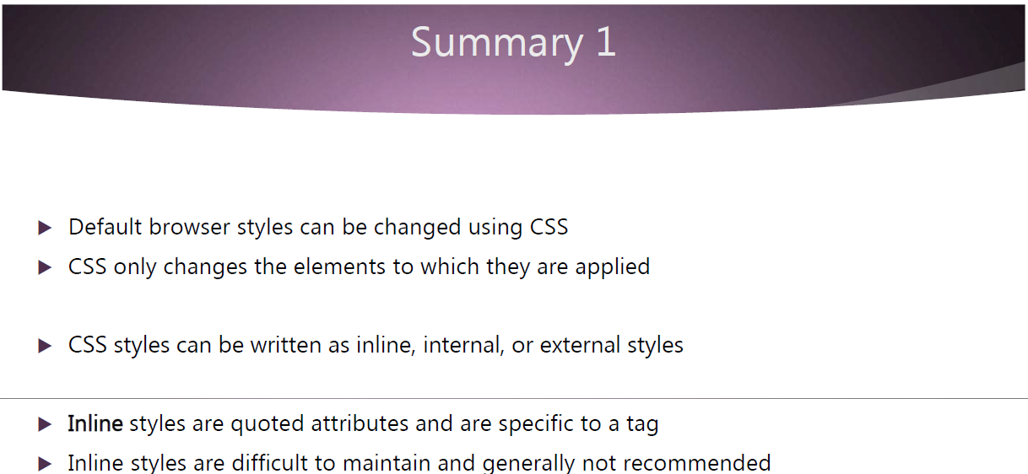

Slide 43
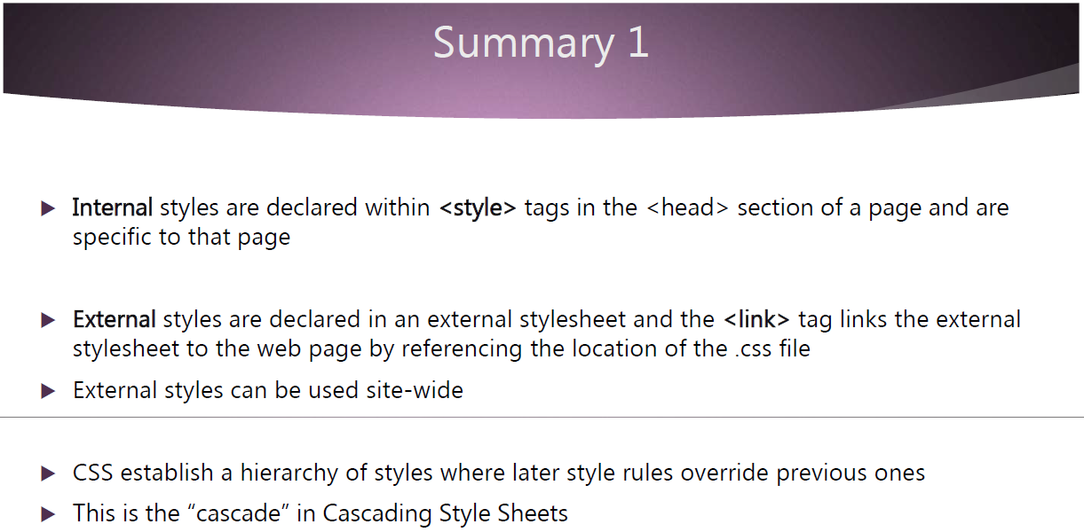

Slide 44
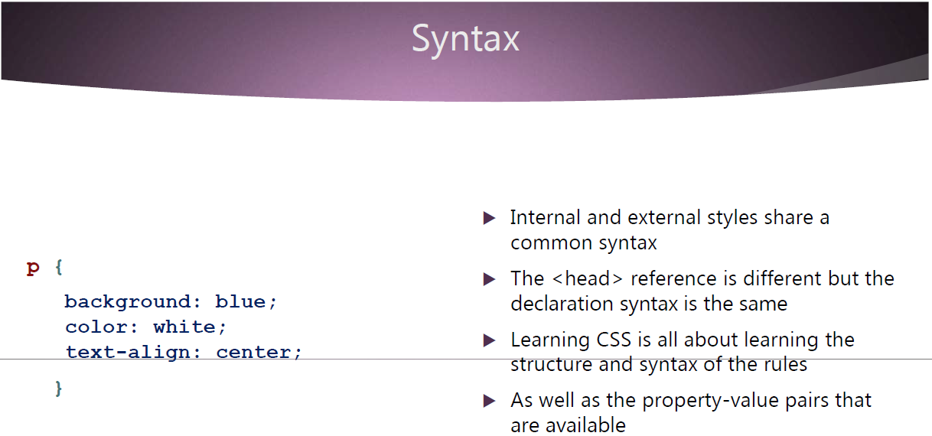

Slide 45
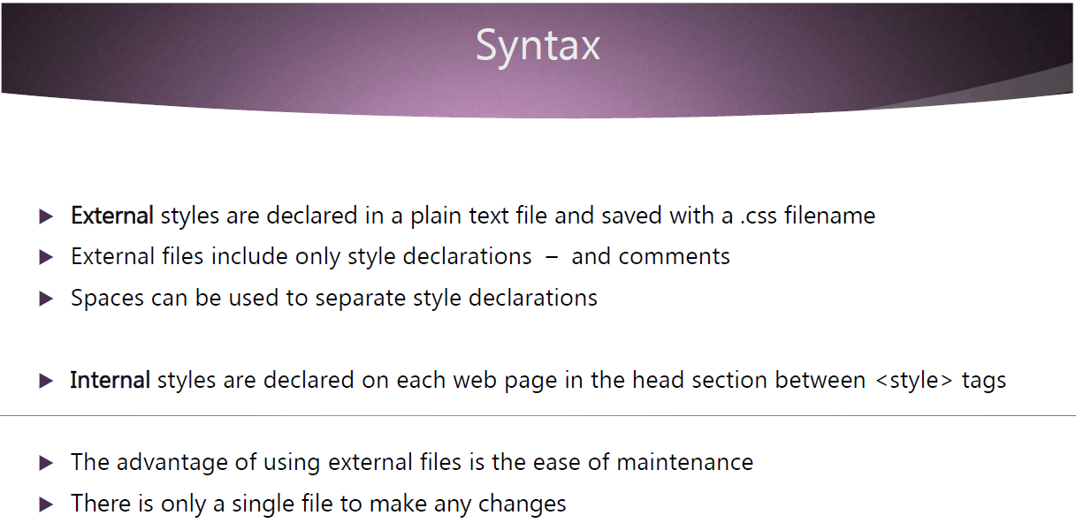

Slide 46
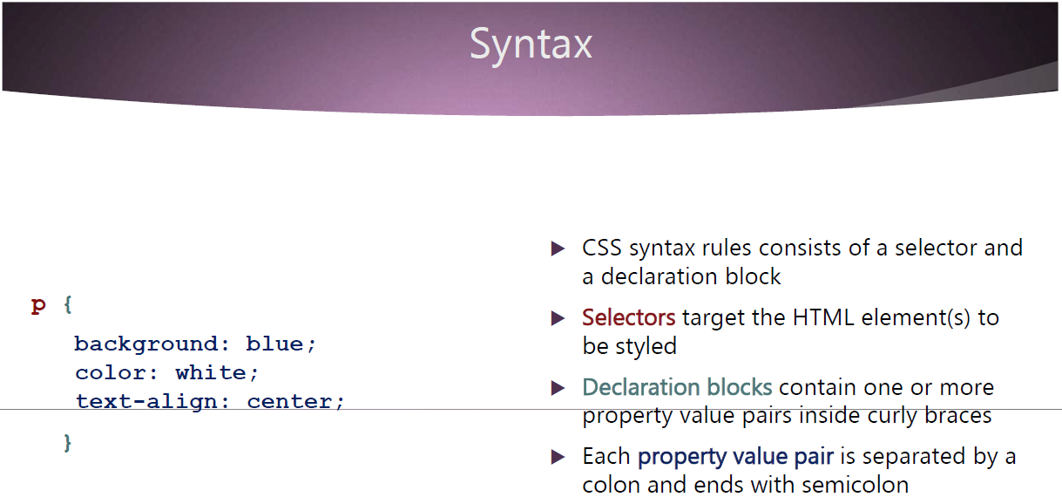

Slide 47
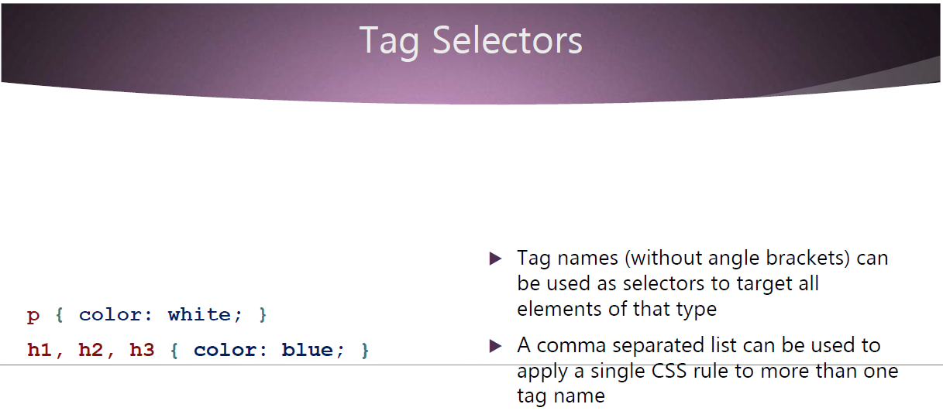

Slide 48
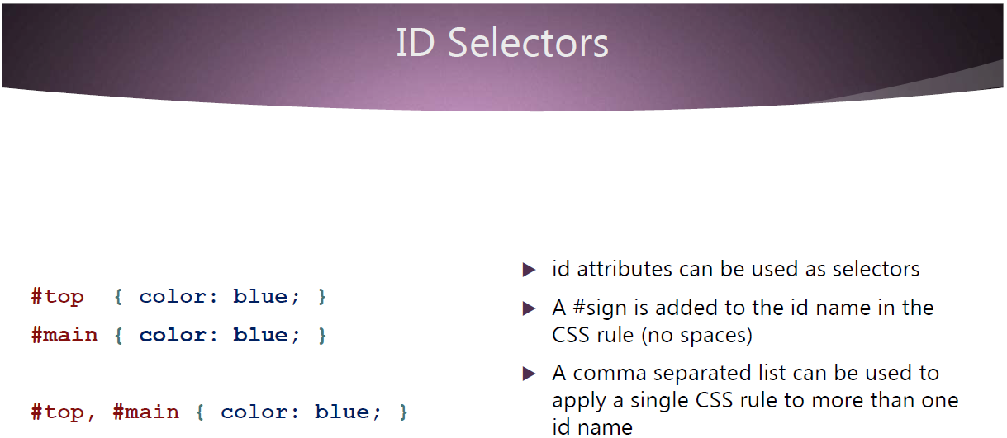

Slide 49
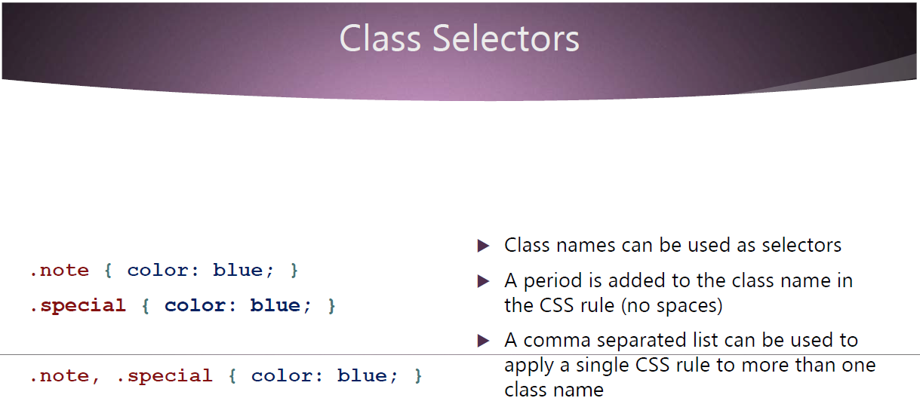

Slide 50


Slide 51


Slide 52


Slide 53


Slide 54


Slide 55


Slide 56


Slide 57


Slide 58


Slide 59


Slide 60


Slide 61


Slide 62


Slide 63


Slide 64

JavaScript is a lightweight, interpreted programming language. It is designed for creating network-centric applications. It is complimentary to and integrated with Java. JavaScript is very easy to implement because it is integrated with HTML. It is open and cross-platform.

Slide 65
Javascript Topics :
Output
Syntax
Variables
Data Types
Conditionals
Functions
Scopes
Closures
Loops / Iterations
Objects and Arrays
Looping

Slide 66


Slide 67


Javascript Syntax and Output

Slide 68


Slide 69
Advantages of JavaScript
The merits of using JavaScript are −
Less server interaction − You can validate user input before sending the page off to the server. This saves server traffic, which means less load on your server.
Immediate feedback to the visitors − They don't have to wait for a page reload to see if they have forgotten to enter something.
Increased interactivity − You can create interfaces that react when the user hovers over them with a mouse or activates them via the keyboard.
Richer interfaces − You can use JavaScript to include such items as drag-and-drop components and sliders to give a Rich Interface to your site visitors.

Slide 70
JavaScript Datatypes
One of the most fundamental characteristics of a programming language is the set of data types it supports. These are the type of values that can be represented and manipulated in a programming language.
JavaScript allows you to work with three primitive data types −
Numbers, eg. 123, 120.50 etc.
Strings of text e.g. "This text string" etc.
Boolean e.g. true or false.

Slide 71

JavaScript Variables
Like many other programming languages, JavaScript has variables. Variables can be thought of as named containers. You can place data into these containers and then refer to the data simply by naming the container.
Before you use a variable in a JavaScript program, you must declare it. Variables are declared with the var keyword as follows.

Slide 72

JavaScript Variable Scope
The scope of a variable is the region of your program in which it is defined. JavaScript variables have only two scopes.
Global Variables − A global variable has global scope which means it can be defined anywhere in your JavaScript code.
Local Variables − A local variable will be visible only within a function where it is defined. Function parameters are always local to that function.

Slide 73


Slide 74


Slide 75


Slide 76
JavaScript is a lightweight, interpreted programming language. It is designed for creating network-centric applications. It is complimentary to and integrated with Java. JavaScript is very easy to implement because it is integrated with HTML. It is open and cross-platform.

Slide 78
Javascript Syntax and Output

Slide 80
Advantages of JavaScript
The merits of using JavaScript are −
Less server interaction − You can validate user input before sending the page off to the server. This saves server traffic, which means less load on your server.
Immediate feedback to the visitors − They don't have to wait for a page reload to see if they have forgotten to enter something.
Increased interactivity − You can create interfaces that react when the user hovers over them with a mouse or activates them via the keyboard.
Richer interfaces − You can use JavaScript to include such items as drag-and-drop components and sliders to give a Rich Interface to your site visitors.

Slide 81
JavaScript Datatypes
One of the most fundamental characteristics of a programming language is the set of data types it supports. These are the type of values that can be represented and manipulated in a programming language.
JavaScript allows you to work with three primitive data types −
Numbers, eg. 123, 120.50 etc.
Strings of text e.g. "This text string" etc.
Boolean e.g. true or false.

Slide 82
JavaScript Variables
Like many other programming languages, JavaScript has variables. Variables can be thought of as named containers. You can place data into these containers and then refer to the data simply by naming the container.
Before you use a variable in a JavaScript program, you must declare it. Variables are declared with the var keyword as follows.

Slide 83
JavaScript Variable Scope
The scope of a variable is the region of your program in which it is defined. JavaScript variables have only two scopes.
Global Variables − A global variable has global scope which means it can be defined anywhere in your JavaScript code.
Local Variables − A local variable will be visible only within a function where it is defined. Function parameters are always local to that function.

Slide 87


Slide 88
Loops

Slide 89

While Loop
The most basic loop in JavaScript is the while loop which would be discussed in this chapter. The purpose of a while loop is to execute a statement or code block repeatedly as long as an expression is true. Once the expression becomes false, the loop terminates.

Slide 90


While Loop

Slide 91

do...while Loop
The do...while loop is similar to the while loop except that the condition check happens at the end of the loop. This means that the loop will always be executed at least once, even if the condition is false.

Slide 92


Do While Loop

Slide 93

The 'for' loop is the most compact form of looping. It includes the following three important parts −
The loop initialization where we initialize our counter to a starting value. The initialization statement is executed before the loop begins.
The test statement which will test if a given condition is true or not. If the condition is true, then the code given inside the loop will be executed, otherwise the control will come out of the loop.
The iteration statement where you can increase or decrease your counter.

Slide 94


For Loop

Slide 95

The for...in loop is used to loop through an object's properties. As we have not discussed Objects yet, you may not feel comfortable with this loop. But once you understand how objects behave in JavaScript, you will find this loop very useful.

Slide 96
Object Properties
Object properties are usually variables composed of “attributes”. If an attribute contains functions is called “Object Method” other wise it id considered as “property”

Slide 99
Bootstrap 3
“make designs easier”

Slide 100


Slide 101


Slide 102


Slide 103


Slide 104


Slide 105


Slide 106


Slide 107


Slide 108


Slide 109


Slide 110


Slide 111


Slide 112


Slide 113


Slide 114


Slide 115


Slide 116

https://startbootstrap.com/templates

Slide 117


Slide 118


Slide 119


Slide 120


Slide 121


Slide 122


Slide 123


Slide 124


Slide 125


Slide 126


Slide 127


Slide 128


Slide 129


Slide 130

https://startbootstrap.com/template/small-business

Slide 131


